Slide 1
FHIR-Based and Streaming-Enabled
Healthcare Big Data Repository
- Enabling Big Data Based AI and Streaming Analytics in Healthcare
    Fast River Technologies Inc.
    www.fastrivertech.com

Slide 2
Product Vision
Unified and lambda-based big data repository will replace traditional RDBMS-based data repository in the healthcare domain
FHIR-based: Growing wave of transition to new FHIR interoperability standard creates huge market opportunities

Slide 3
Platform Requirements
SQL and RDBMS on HADOOP/HDFS
  Build on Spice Machine
Mission-critical application and atomic transaction
Scale-out with lower cost
OLTP and OLAP – hybrid or unified

Slide 4
What is FHIR
FHIR - Fast Healthcare Interoperability Resources
Next generation healthcare standard for exchanging healthcare information between systems
Standard RESTful API
Hundreds of resources (messages, documents)

Slide 5
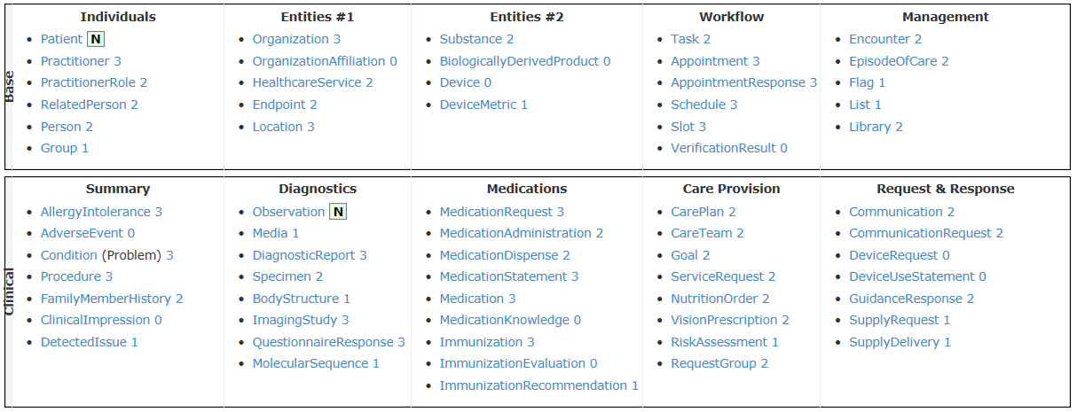
FHIR Resources

Slide 6
FHIR on Splice Machine
Typed relational tables on big data platform
Hundreds of resources - thousands of tables
Tables/Fields extensions
ACID transactions
Realtime and bulk load

Slide 7
Where Are We
Completed FHIR engine 1.0
Completed FHIR API 1.0
Completed FHIR patient resource on Splice-Machine community edition
Completed Initial FHIR Connectathon Test
Will attend official FHIR Connecthathon 05/2019

Slide 8
Issues
SP community version – no software issue
  CLOB/BLOB bug fixed
Need high-volume performance testing
Need clustered SP with three nodes
Need advanced training

Slide 9
Request for New Features
Support XML data type natively as Oracle database supports
Support JSON data type natively as Oracle database supports
Support collection data types as Oracle database supports
Support Text index as Oracle database supports

Slide 10
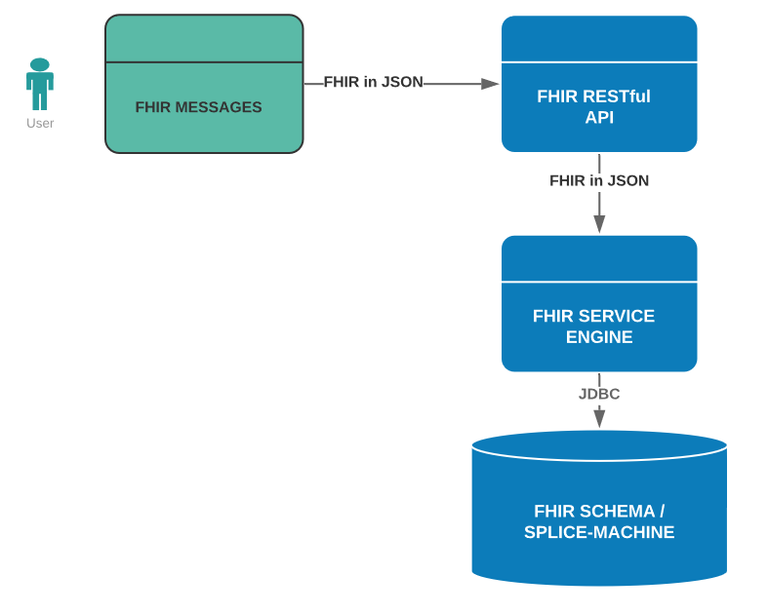
FHIR Patient Registry
Data Flow

Slide 11
Thank You

